Slide 1
Assignment01 22092022
CreateVNet, VM, and Hosting Website on that VM

Slide 2
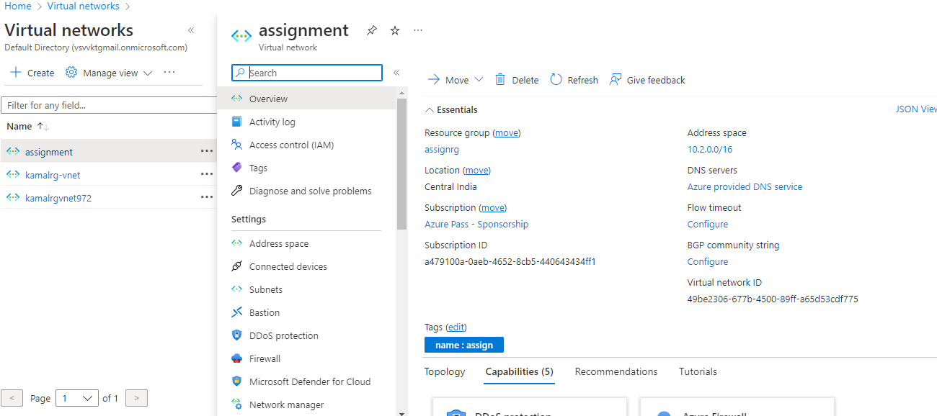
Created V-Net with 2048ips,

Slide 3
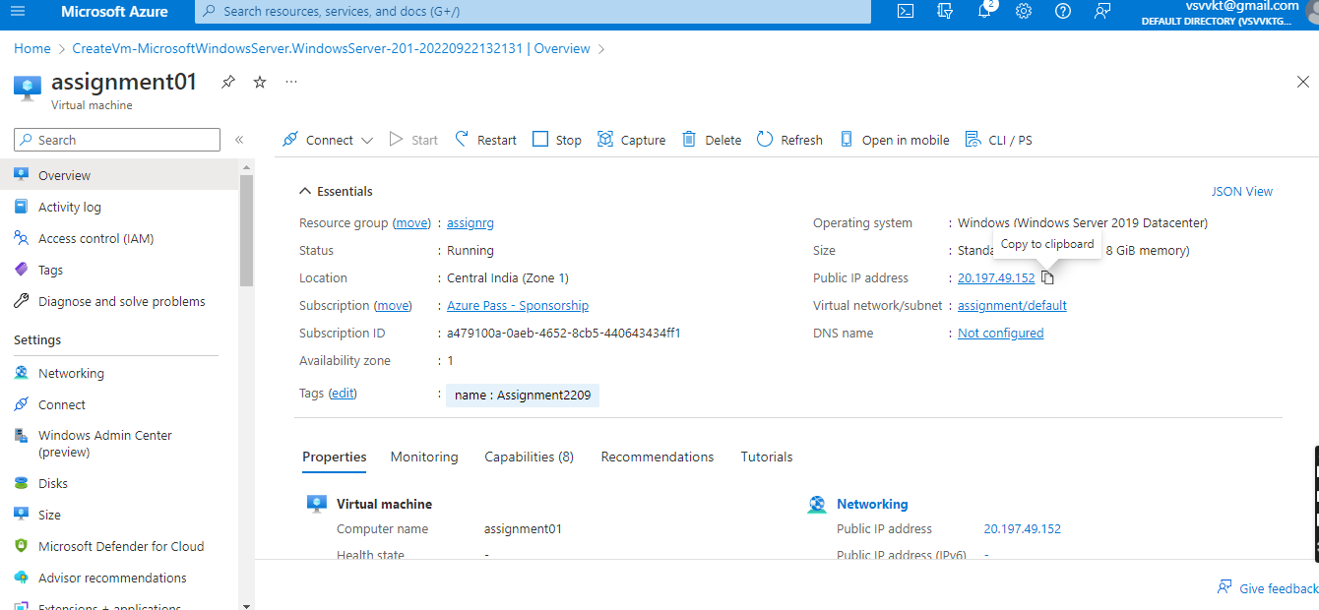
Created Windows VM, Launched in V-Net

Slide 4
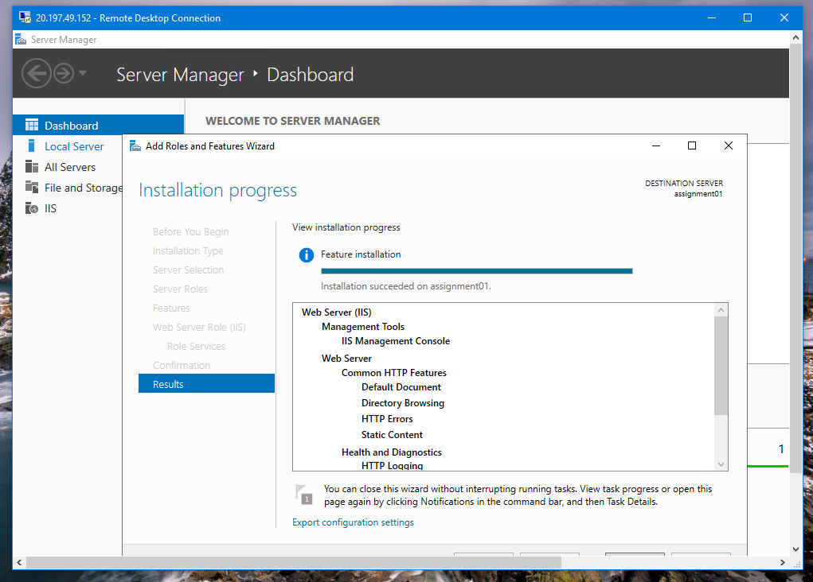
Changing configurations and Installing Webserver in Server-Manager

Slide 5
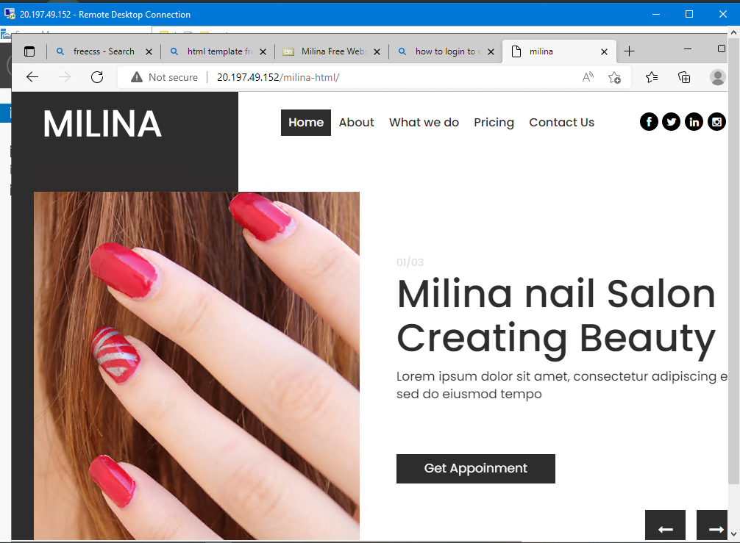
Successfully Hosted the Website in VM milina

